Slide 1
MELBOURNE
HOUSING PRICES
Predicting Housing Prices in Melbourne, Australia
Presented by Usman Shaikh

Slide 2
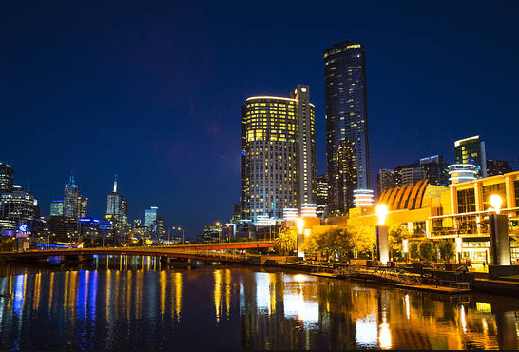
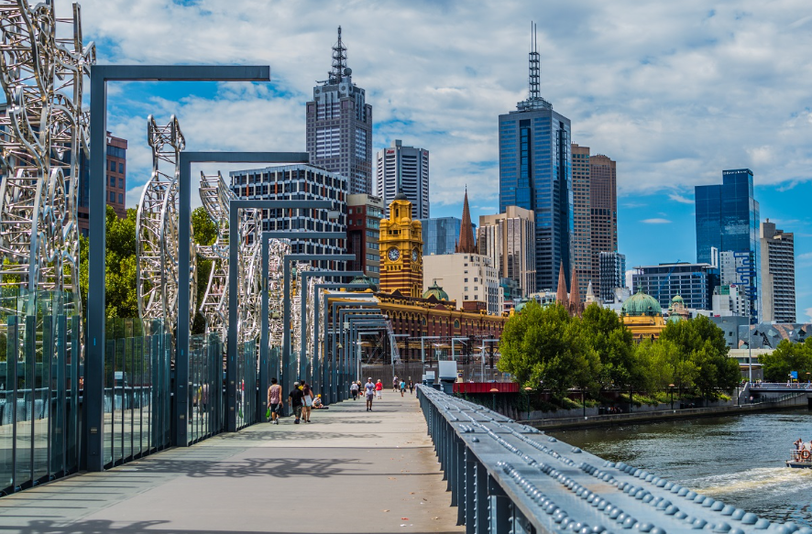

Dataset: Melbourne housing clearance data from Jan 2016
Source: https://www.kaggle.com/anthonypino/melbourne-housing-market

Slide 3
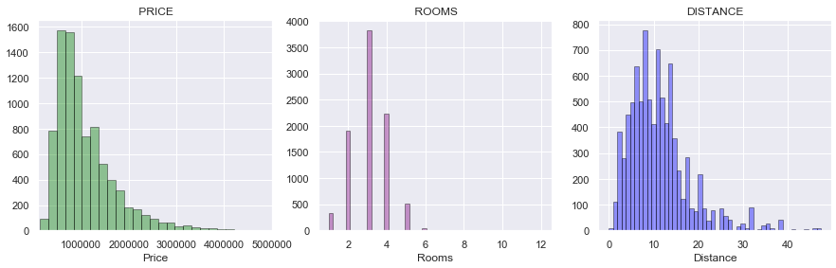
Exploratory Analysis: Understanding the Dataset – I
Mean : 1,092, 902
Mode : 3
Mean : 11.19
Bulk of the housing prices in Melbourne Australia fall between 0 to 1.5 Million Dollars with a mean value of $1,092,902.
Most places have 3 rooms and are located at a mean distance of 11.19 Kilometers from the Central Business District.
Most properties are located with in a range of 18 Kilometers from Central Business District (CBD).

Slide 4
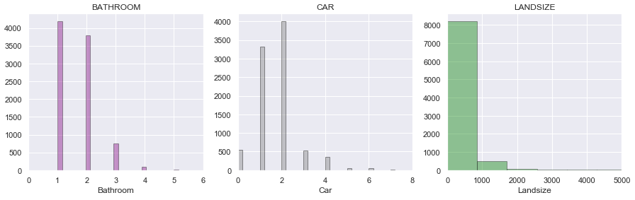
Exploratory Analysis: Understanding the Dataset – II
Mode : 1
Mode : 2
Mean : 523.48
The common number of Bathrooms per property appears to be 1 followed by 2 car spaces.
The Land size of most properties fall between 0 to 2,500 Square Meters, with over 90% of the values falling under 1,000 Square Meters.

Slide 5
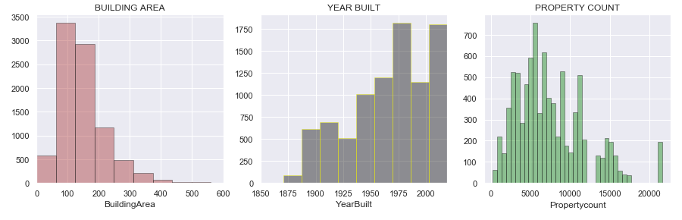
Exploratory Analysis: Understanding the Dataset – III
Mean : 149.30
Mean : 1965
Mean : 7475.94
The building area for most of the properties fall between 50 and 200 Square Meters with a mean value of 149.30
The housing construction shows a gradual rising trend over the years with a mean value year of 1965.
The housing market witnessed increased amount of construction in mid seventy’s , late 90’s followed by 2000’s.

Slide 6
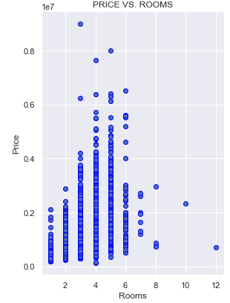
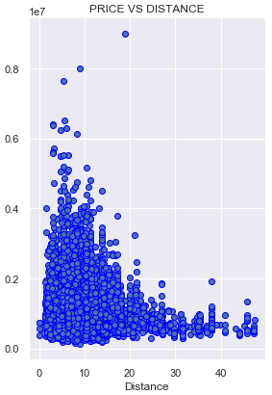
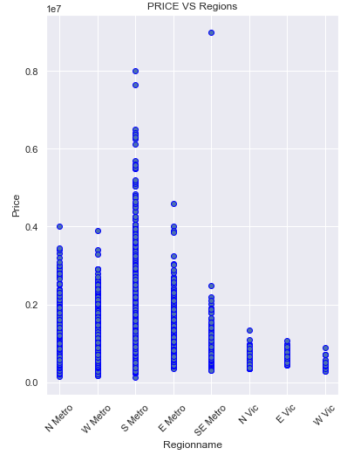
Relationship between Price and other Factors – I
The housing prices appear to increase with the number of rooms but starts to fall after 5 rooms
Likewise the price appears to rise with fall in distance with highest values for properties located in a 5 to 6 Km radius from CBD.
Region wise South Metro is closest to the Central Business District and appears to be most expensive followed by East Metro.

Slide 7
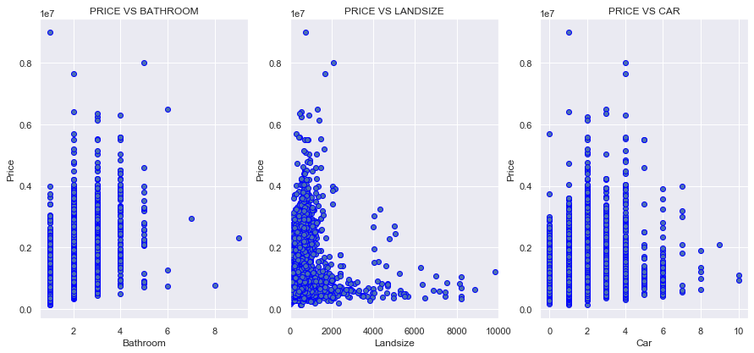
Relationship between Price and other Factors – II
The housing prices appear to increase with the number of Bathrooms however price starts to fall after a number of 3 Bathrooms.
Majority of the land size falls under 1500 Square Meters and the price is highest around 1000 Square Meters.
The price is highest for 4 car spaces however it starts to fall once it reaches four car spaces

Slide 8
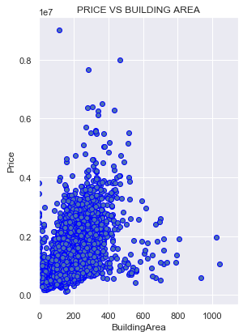
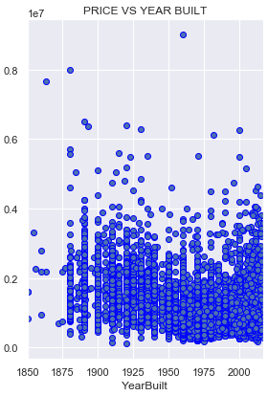
Relationship between Price and other Factors - III
There appears to be a correlation between Price and Building Area, 0.51 to be precise on a scale of -1 to 1
The priciest properties seem to be built in early 1900’s, late 90’s and 2000’s , as population in those years appear more dense.
Price analysis show that homes with 3 bedrooms, 2 bathrooms, 2 car spaces, land size of 1000 Sqm, building area of 300 Sqm built in early 1900’s, late 90’s and 2000’s appear to be of higher price.
Similarly as distance increases from the Central Business District land size and building area increase with decrease in price.

Slide 9
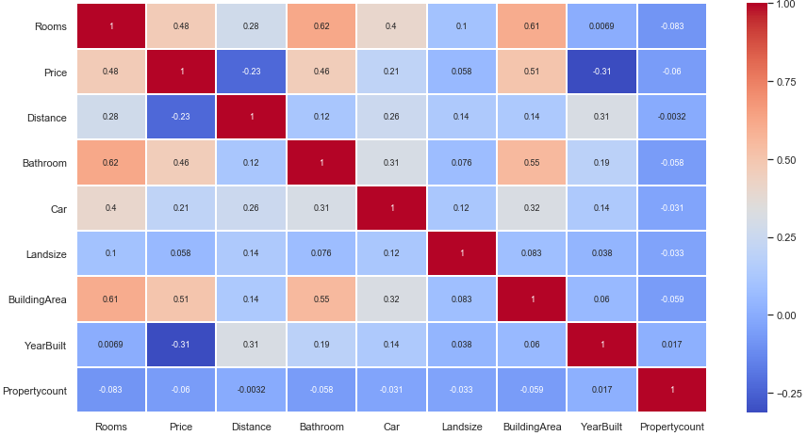
Correlation HEAT MAP – Understanding influence of factors on each other and Price
There appears to be a slightly higher correlation between number of Rooms and Bathrooms 0.62
Correlation between Building Area and Rooms is 0.61, followed by Building Area and Bathroom 0.55 and 0.51 for Building Area and Price.

Slide 10
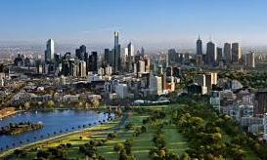
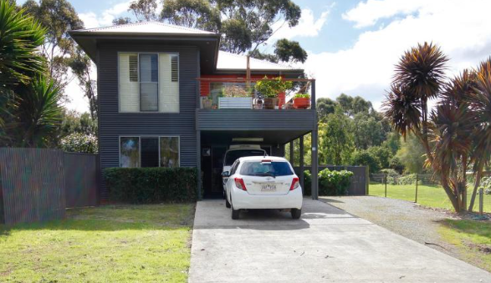
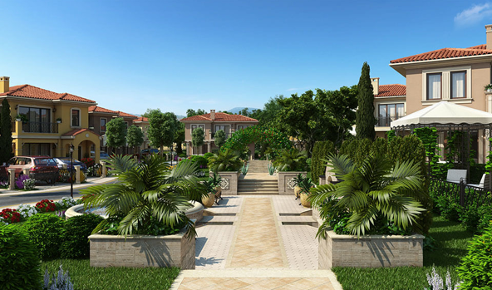
Analysis by Regions
To simplify analysis and visualizations city regions have been assigned abbreviated names as follows.
Northern Metropolitan: N Metro
Western Metropolitan: W Metro
Southern Metropolitan: S Metro
Eastern Metropolitan: E Metro
South-Eastern Metropolitan: SE Metro
Northern Victoria: N Vic
Eastern Victoria: E Vic
Western Victoria: W Vic

Slide 11
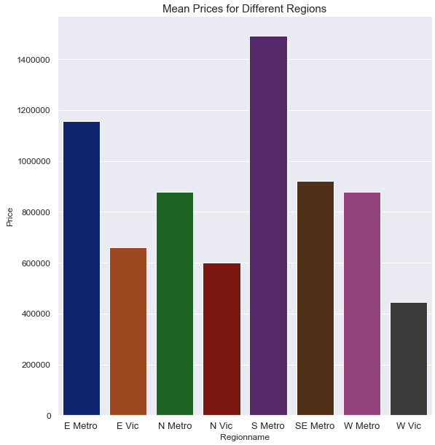
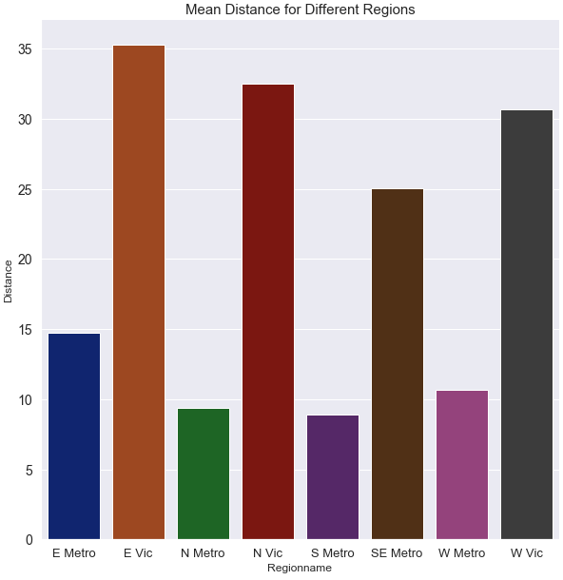
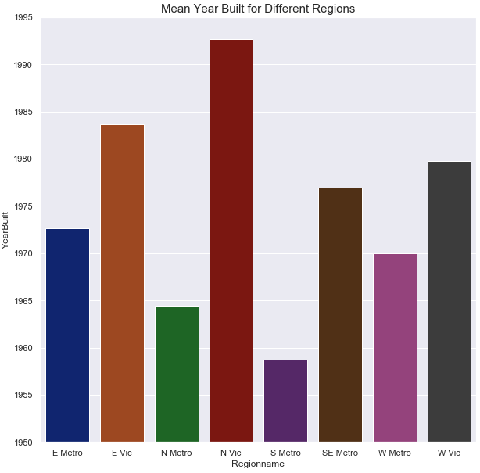
Mean Values – Analysis by Regions – I
The regions closest to CBD including N Metro, S Metro, E Metro appear to have a higher price with 50’s, 70’s and 90’s construction.
Where as regions with higher distance appear to have newer construction and lower price for example North Victoria.
Notes:
W Vic appears to be cheapest in price 3rd largest in distance, small land size, larger building area, more rooms, car spaces and less bathrooms.

Slide 12
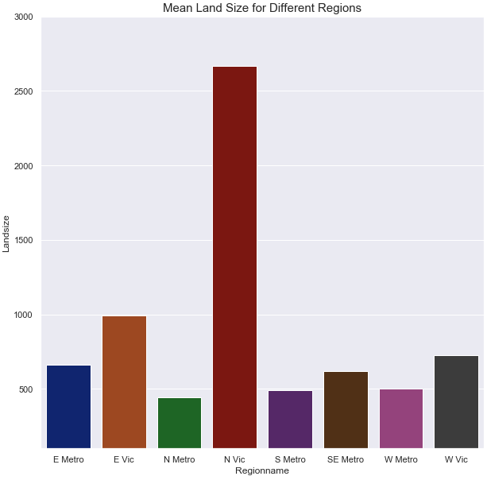
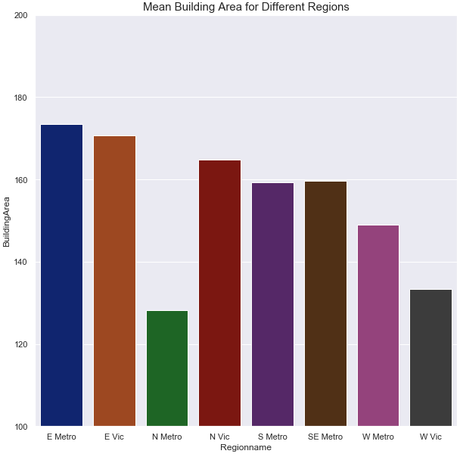
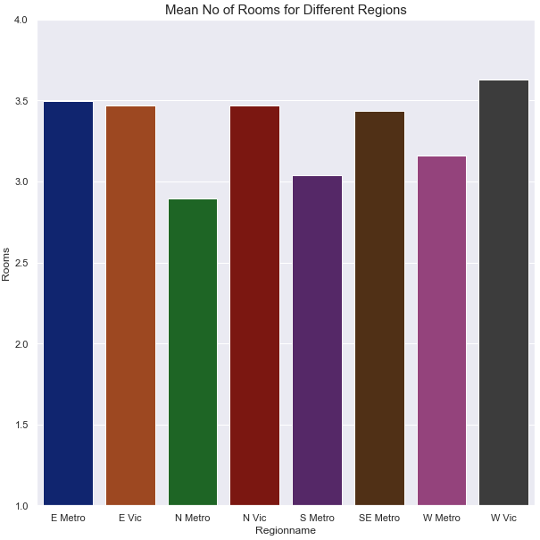
Mean Values – Analysis by Regions – II
Regions closer to the CBD appear to have less land size and building but higher no of rooms (Apartment buildings)
Where as regions such as North and East Victoria which are located at a distance have higher land size and building area with higher number of rooms

Slide 13
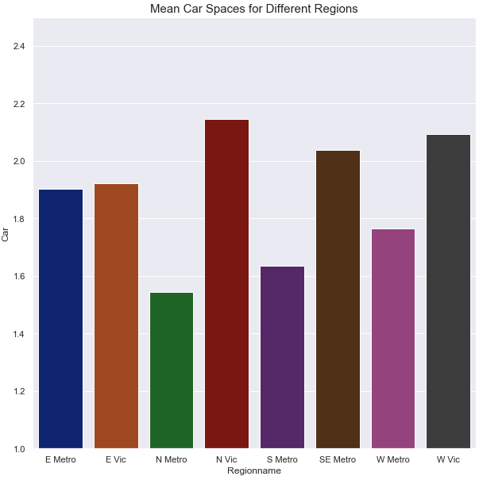
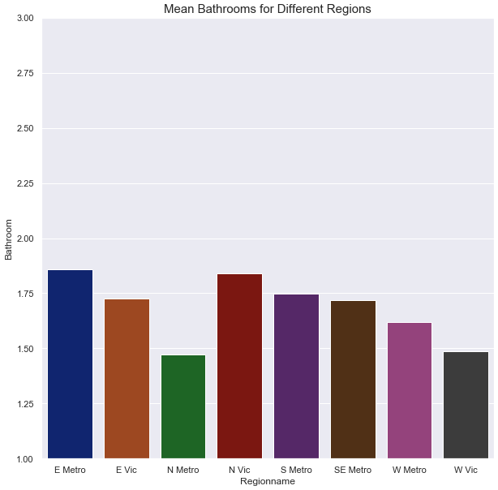
Mean Values – Analysis by Regions – III
Regions closer to CBD like North, South and West Metro are expensive with less land and building size and have fewer car spaces.
Whereas farther regions like North and West Victoria considering higher land and building size have more car spaces
No of Bathrooms is correlated with rooms 0.62. From previous analysis it can be inferred that for a property with three rooms there are 1.5 to two Bathrooms available.

Slide 14
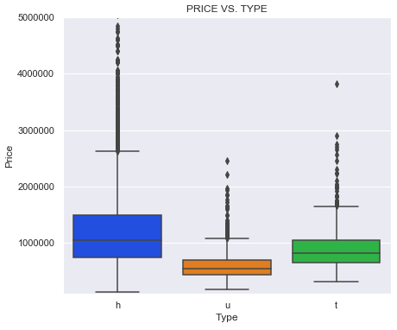
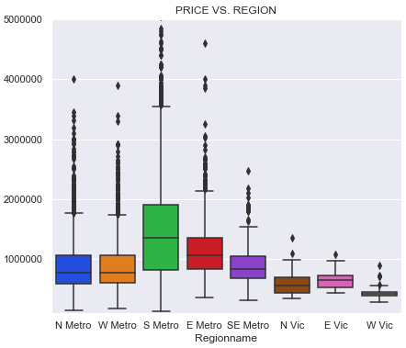
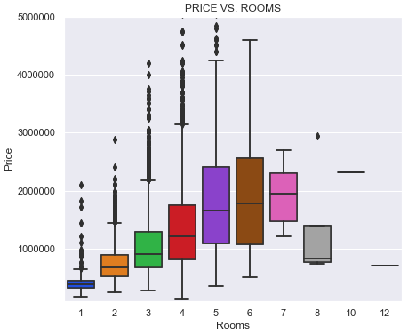
Price Analysis using Box Plots – I
The prices of homes appear to be higher followed by town homes and then units.
South Metro region closest to CBD appears to have the highest price followed by E and SE Metro regions.

Slide 15
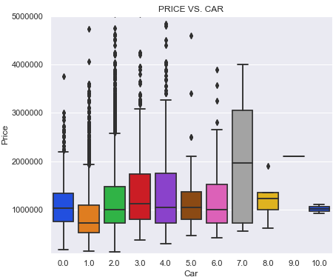
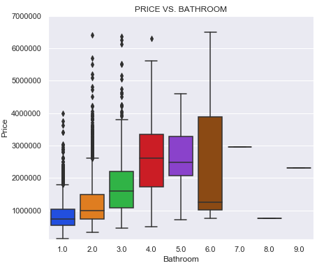
Price Analysis using Box Plots – II
Properties with higher no of car spaces and Bathrooms appear to be costly.
Whereas properties with 3 car spaces and 3 Bathrooms have median values of approximately 1 to 1.5 Million Dollars

Slide 16
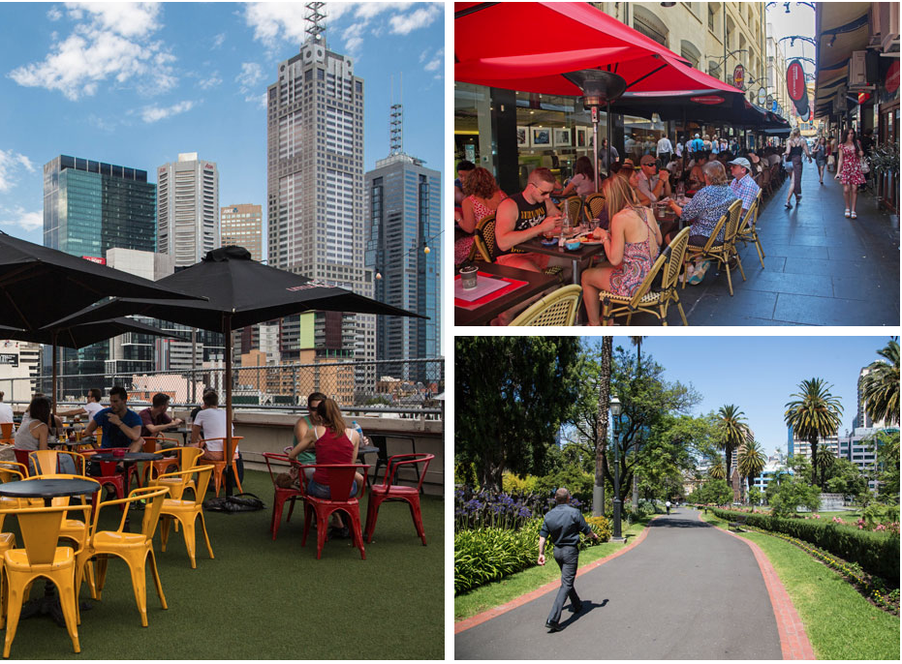
Problem Statement
As analyzed and discussed in exploratory analysis the home prices in Melbourne
depend upon several different factors.
The purpose of this project is to identify the following.
Discover important factors which drive prices in the Melbourne housing market.
Explore relationship between different factors and their relationship with price.
Analyze the most significant factors that impact housing prices
Prepare a Model based upon identified factors and accurately predict housing prices.
Compare Models for accuracy
Our Target or Dependent variable for this analysis will be Price.
Where as important features will be selected using a machine learning algorithm.

Slide 17

Machine Learning Models
For this project we will be using two different algorithms, Random Forest and Multiple Linear Regression in order to predict price of housing in Melbourne Australia.
Random forest is an ensemble learning method for classification and regression which builds multiple decision trees and merges them together to get a more accurate and stable prediction.
Multiple Linear Regression is used to explain the relationship between one continuous dependent variable and two or more independent variables.
In present scenario our dependent variable is Price whereas the multiple independent variables include distance, land size, building area, room etc.
Reason for choosing the models:
Random Forest – The dataset appears to have large no of variables. The algorithm will help us identify most important features.
No of original variables 21
No of extended variables 229
Multiple Linear Regression – The algorithm will tell how much does our dependent variable Price changes with an amount of change in the independent variables.

Slide 18
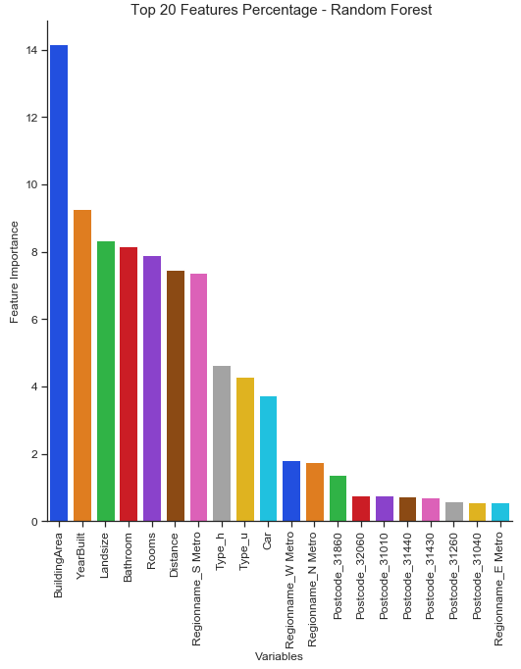
Model Parameters and Results
Model Parameters
Variables: 212
n_estimators: 500
max_depth: 30
max_features: 5
Model results
R²: 0.9075292579394669
Mean Absolute Error: 192502.5338020192
Mean Squared Error: 112849021410.40366
Root Mean Squared Error: 335930.084110375

Slide 19
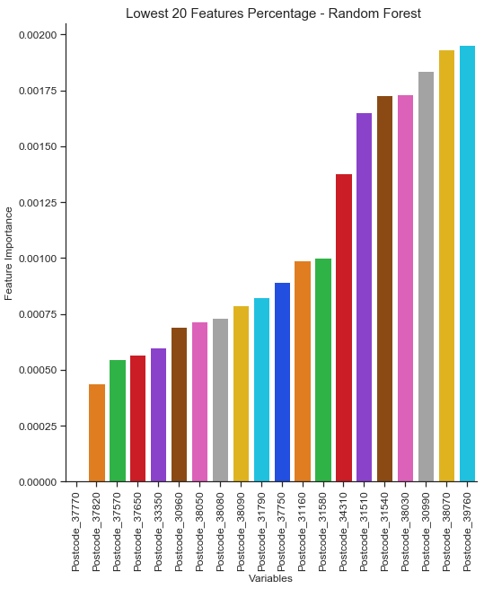
Model Parameters and Results

Slide 20
Random Forest Results with Minimum Features
Random Forest: 20 Variables
R²: 0.9735487519831745
Mean Absolute Error: 175026.1266441378
Mean Squared Error: 97608745576.68251
Root Mean Squared Error: 312423.98367712187
Random Forest: 10 Variables
R²: 0.9705364977902087
Mean Absolute Error: 189800.32868850665
Mean Squared Error: 107871768771.14671
Root Mean Squared Error: 328438.37895585026
Rooms
Distance
Bathroom
Car
Landsize
BuildingArea
YearBuilt
Type_h
Type_u
Postcode_31010
11. Postcode_31220
12. Postcode_31260
13. Postcode_31420
14. Postcode_31430
15. Postcode_31440
16. Postcode_31860
17. Postcode_32060
18. Regionname_N Metro
19. Regionname_S Metro
20. Regionname_W Metro
Rooms
Distance
Bathroom
Car
Landsize
BuildingArea
YearBuilt
Type_h
Type_u
Regionname_S Metro

Slide 21
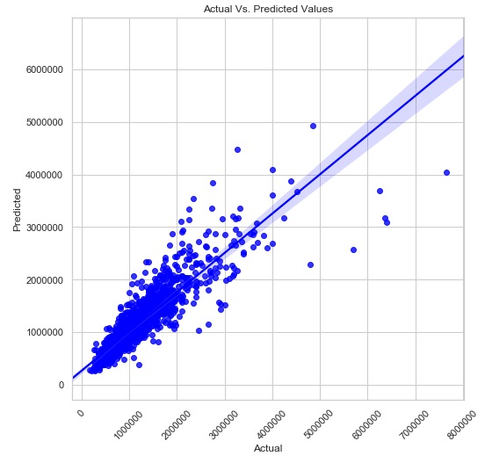
Scatter Plot for Actual and Predicted Values
Random Forest: 10 Variables
R²: 0.9705364977902087
Mean Absolute Error: 189800.32868850665
Mean Squared Error: 107871768771.14671
Root Mean Squared Error: 328438.37895585026
Rooms
Distance
Bathroom
Car
Landsize
BuildingArea
YearBuilt
Type_h
Type_u
Regionname_S Metro

Slide 22
Multiple Linear Regression
Rooms
Distance
Bathroom
Car
Landsize
BuildingArea
YearBuilt
Type_h
Type_t
Type_u
Postcode_31010
Postcode_31040
Postcode_31220
Postcode_31430
Postcode_31440
Postcode_31860
Postcode_32060
Regionname_N Metro
Regionname_S Metro
Regionname_W Metro
Multiple Linear Regression
Multiple Linear Regression: 10 Variables
R²: 0.6508013275396825
Mean Absolute Error: 270026.5215419841
Mean Squared Error: 199180495674.14444
Root Mean Squared Error: 446296.4213100352
Multiple Linear Regression: 20 Variables
R²: 0.6707313080332801
Mean Absolute Error: 266941.42276920174
Mean Squared Error: 195580653515.56674
Root Mean Squared Error: 442245.0152523675

Slide 23
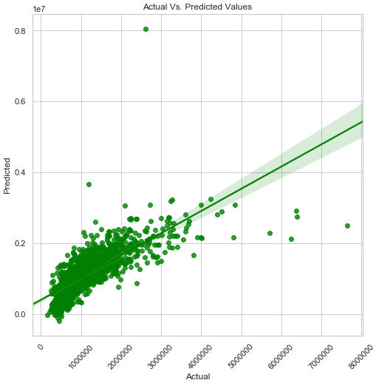
Linear Regression Coefficients
Rooms
Distance
Bathroom
Car
Landsize
BuildingArea
YearBuilt
Type_h
Type_t
Type_u
Postcode_31010
Postcode_31040
Postcode_31220
Postcode_31430
Postcode_31440
Postcode_31860
Postcode_32060
Regionname_N Metro
Regionname_S Metro
Regionname_W Metro
S.no | Variables | Coefficient Estimate
1 | Postcode_31260 | 740516.7396
2 | Postcode_31440 | 636884.4561
3 | Postcode_31860 | 596842.1657
4 | Postcode_31430 | 543142.8045
5 | Postcode_32060 | 364636.9139
6 | Postcode_31010 | 168940.24
7 | Postcode_31040 | 168528.4138
8 | Bathroom | 163205.2469
9 | Type_h | 161929.6982
10 | Regionname_S Metro | 158675.6955
11 | Rooms | 102767.3732
12 | Car | 40614.72099
13 | Type_t | 21348.70709
14 | BuildingArea | 2035.330849
15 | Landsize | 21.885221
16 | YearBuilt | -3387.27217
17 | Distance | -33660.01369
18 | Type_u | -183278.4053
19 | Regionname_N Metro | -258456.5366
20 | Regionname_W Metro | -324693.217

Slide 24
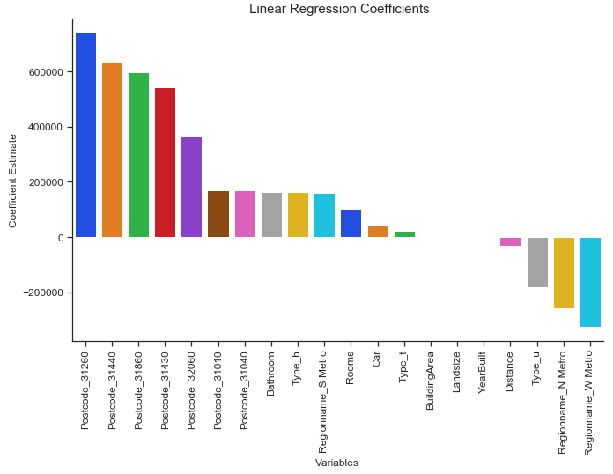
Linear Regression Coefficients

Slide 25
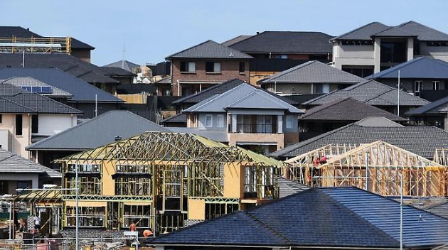
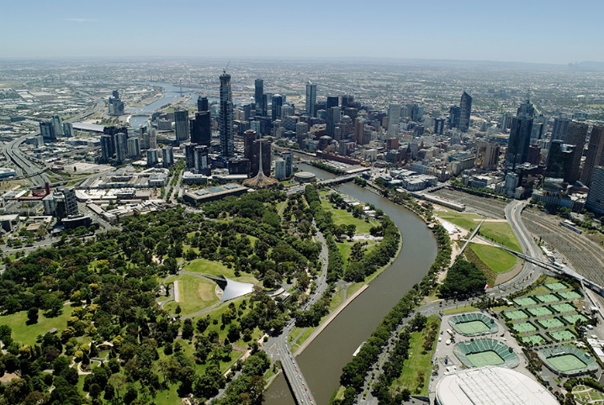
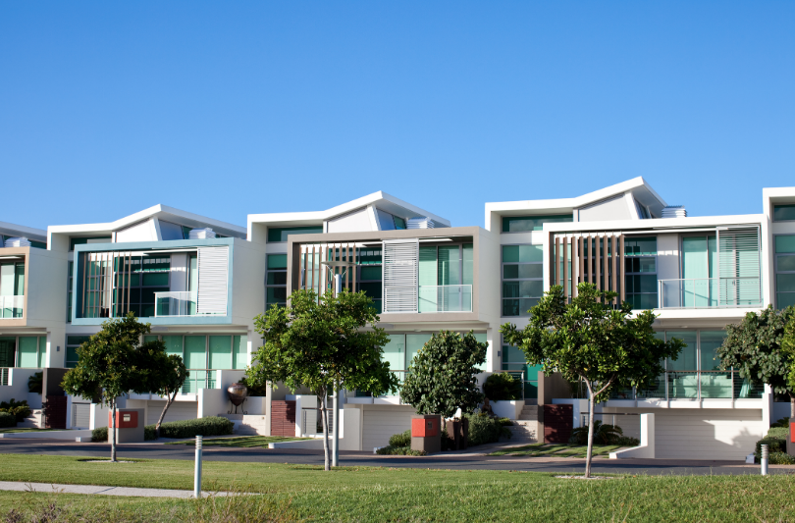
FINDINGS
Most important factors impacting price of housing in Melbourne are ranked as follows.
Rooms
Distance
Bathroom
Car
Landsize
BuildingArea
YearBuilt
Type_h
Type_u
Regionname_S Metro

Slide 26
CONCLUSION
E Vic, N Vic, W Vic appear to have cheaper price, large distance, large land size, more car space with 80’s and 90’s construction.
E Metro, N Metro, S Metro appears to have higher price, short distance, less land size, slightly less car space and 50’s, 60’s construction
SE Metro appears to be expensive located at a distance with 2 car spaces and mid 70’s construction.
W Vic appears to be cheapest in price, 3rd largest in distance, small land size, larger building area, more number of rooms, car spaces and less bathrooms.
The supervised learning model appears to have high variance and low bias.

